Slide 1
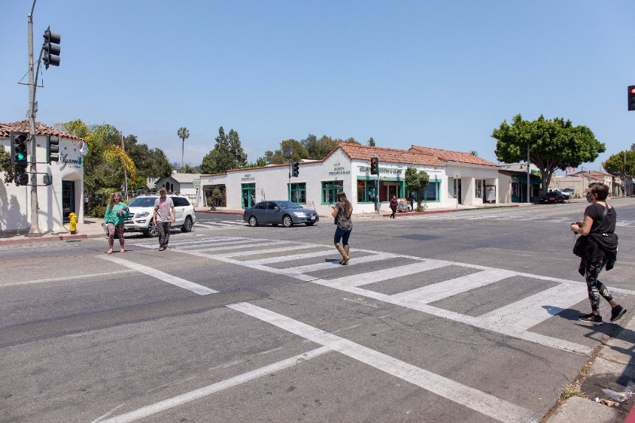
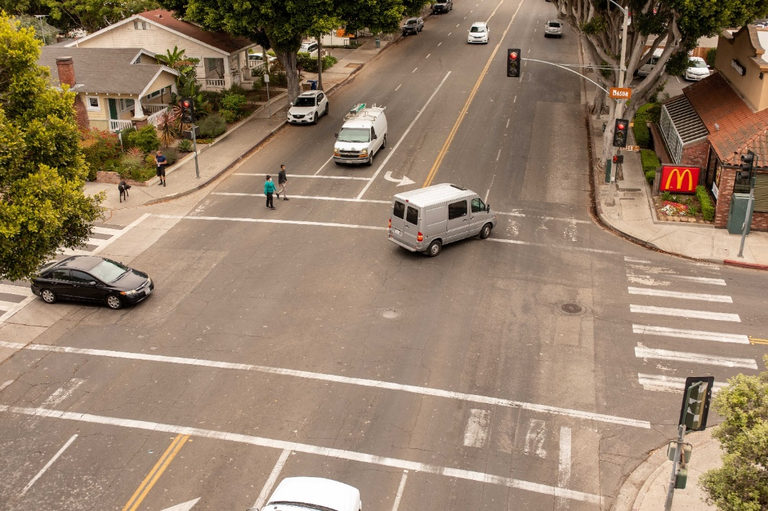
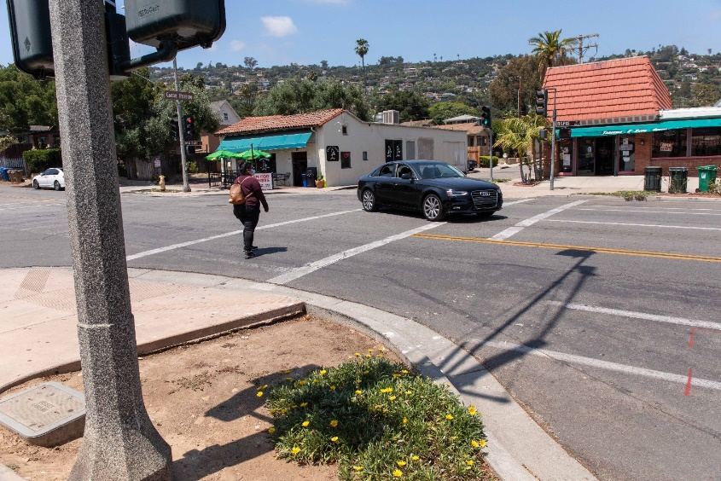
Milpas Street Crosswalk Safety and Sidewalk Widening Project Existing Conditions
With State Active Transportation Cycle 6 funding, crosswalk safety enhancements, traffic signal improvements, lighting improvements, accessibility improvements, bus stop improvements, and major sidewalk repair will be constructed. The project will be implemented at the same time as a City-funded pavement restoration project. Milpas Street is also a Vizion Zero priority corridor, ranking ninth in the City for highest number of collisions resulting in severe or fatal injuries.

Slide 2
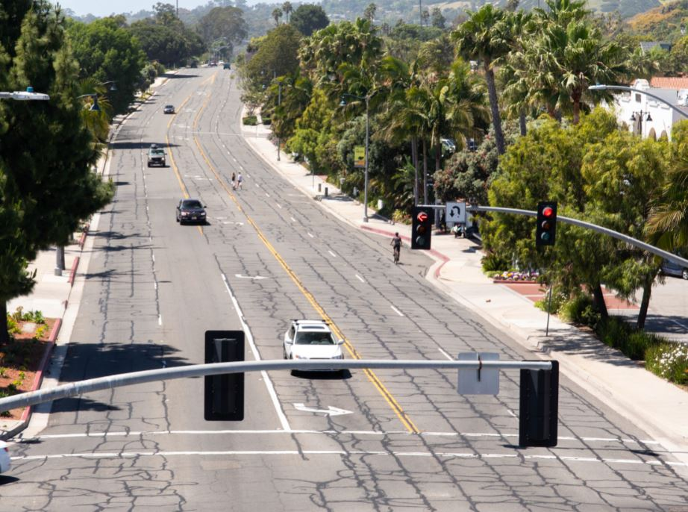
Cliff Drive: Urban Highway to Complete Street Transformation Existing Conditions
With State Active Transportation Program Cycle 6 funding, a new 3.1-mile-long separated path from Arroyo Burro County Park to Castillo Street, three new traffic signals, eight new pedestrian-activated flasher crosswalk systems, and sidewalk widening connecting Cliff Drive to Monroe and McKinley Elementary Schools will be constructed. Safety enhancements are an important part of the project as Cliff Drive is the City’s highest priority Vision Zero corridor ranking first for highest number of collisions resulting in severe or fatal injuries.

Slide 3
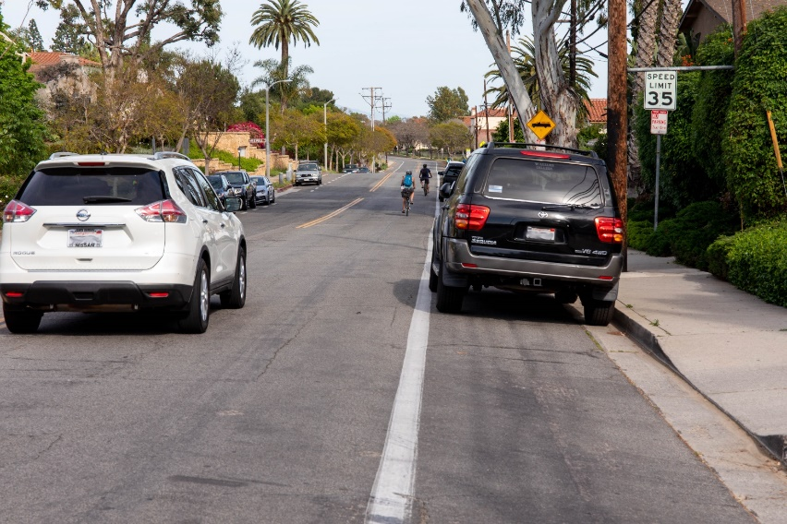
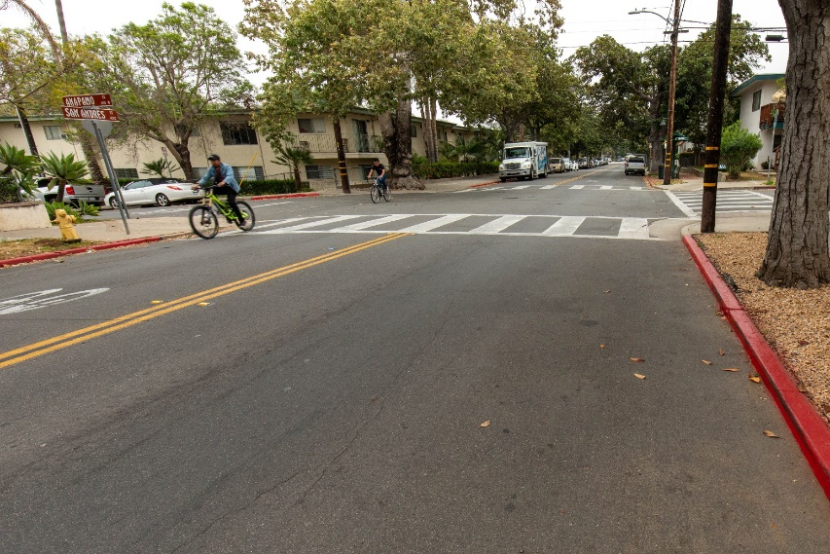
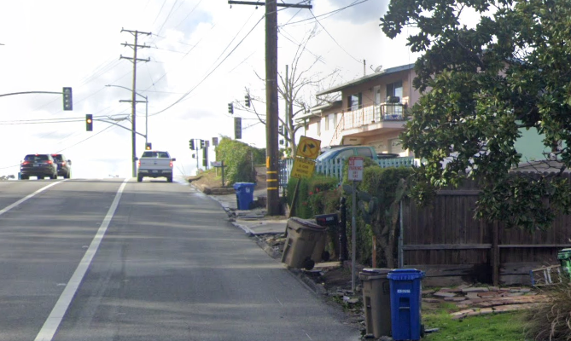
Westside and Lower West Neighborhood Active Transportation Plan Implementation Existing Conditions
With State Active Transportation Cycle 6 funding, the project includes new sidewalks, crosswalks, lighting, and cycling connections to improve neighborhood livability and safety. The project also includes completing the sidewalk on Euclid Avenue for a pedestrian connection to the Westside Neighborhood Center as well as adding continuous sidewalk on Calle Real between Treasure Drive and Las Positas Road to provide a pedestrian connection to the Junipero Street overcrossing. The project features were identified through the Westside and Lower West Neighborhood Transportation Plan.

